Slide 1
Microsoft Azure

Slide 2
What is Azure?
Definition

Slide 3
PaaS – IaaS - Saas
Responsibility vs. Control

Slide 4
Ecosystem
<<TBD - IMAGE>>

Slide 5

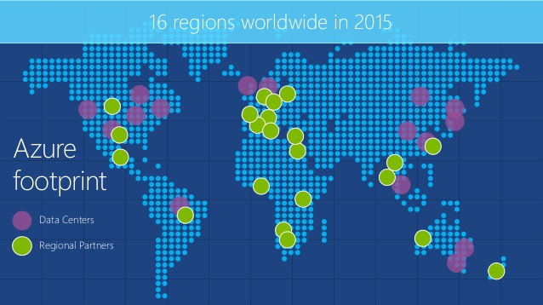
Azure Region & Data Centers

Slide 6
Azure - Website

Slide 7
Website - Introduction
Runs on IIS8 with Windows Server 2012
PAAS
Web Sites vs. VM
Web Sites VS Cloud Apps VS Virtual Machine { Hotel analogy}

Slide 8
Deployment
4 Main Types
FTP
Web Deployment using VS
Kudu
Deployment from master branch
Change branch and sync
TFS
Publishing Profile

Slide 9
Debugging
Web
FTP

Slide 10
Monitoring / Health
Add Metrics
Setup Rule Alert

Slide 11
Configuration
DNS lookup
Region
Appear / Disappear depending on capacity
Scale
Tiers
Instance Count
Billing = (number of instances * number of core) in hours
Dedicated VM
Manual vs. Auto
Endpoint monitoring
App Setting , connection string manipulation using PowerShell

Slide 12
Configuration continue
Logging
Application logging
Web logging
Kudu logging
Live stream logging
Web Site Log Viewer Extension by Amit Apple

Slide 13
Deployment
Deployment using GIT - Kudu
Deployment Slots

Slide 14
Multiple Technologies Support
Bring your own framework
HTML
Node
ASP.NET Web Form
ASP.NET MVC
Razor
PHP
Gallery
MS works with open source community for integration

Slide 15
Advanced Features
How to maintain state with different instances
UNC Share contains directory structure and all instance VMS running point to that UNC path
FileZilla with FTP
Traffic Manager
Create 2 websites in different regions and add those two endpoints in traffic manager configuration
Use VM in specific region to find the actual address using nslookup
Custom Domain
Edit with Visual Studio Online
Backup and Restore
Delete file using FileZilla
Automated backup
Integrate with Redis Cache

Slide 16
Azure - Scheduler

Slide 17
Azure – Scheduler
Introduction
Setup in Dashboard
Frequency
Scale - Constraint scale not horizontal or vertical like VM or websites. Limitation between free and standard tier
History
Management URL in fiddlers
~ after resources/scheduler/~/jobcollection

Slide 18
Azure – Mobile Services

Slide 19
Mobile Services
Backend in a box
Support multiple platforms
Intercept server side JavaScript for any CRUD operation
Web editor intellisense

Slide 20
Azure – API Management

Slide 21
What is API Management?
API Management allows organizations to publish APIs reliably, securely and at scale. Use API Management to engage with and drive API consumption among developers, partners and even internal teams while benefiting from the business and operational insights available.

Slide 22
What are the challenges?
No documentation in current SOA world, so how do you engage developers across platform to use your API
How to reduce TTFSC - Time to first successful call? solution is interactive console
How do you make legacy API modern? iOS developer needs JSON rather than XML, so how your API supports different data formats or transformations?
How is your API doing? Analytics requirement. Which region is calling your API frequently? Where do you need to focus more, how can you scale it, failure ratio...
How do you protect core business system?
How can you give it to developers across platforms?
How to limit number of calls using rate limit?

Slide 23
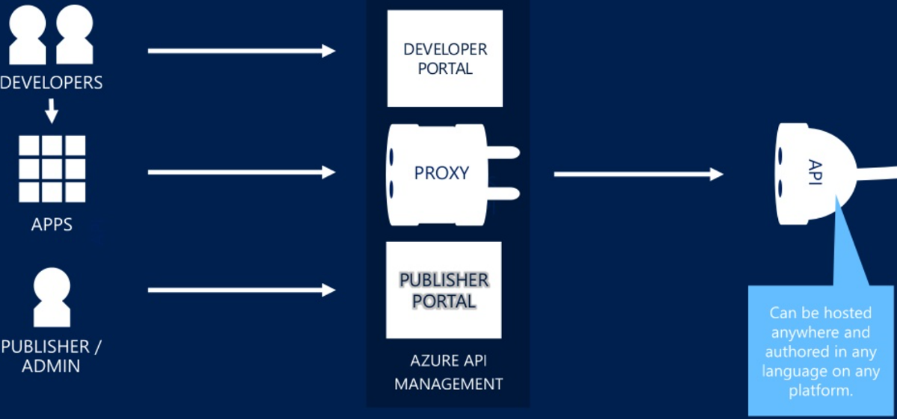
How does it work?

Slide 24
Where it is implemented?
Twilio - API to send text messages or phone calls to the patient night before the appointment.
Fitbit – Calls cloud enabled API to save the health data
Walgreens - Walgreens photo print API allows developer to build compelling app across different platforms and used it to print photos. With every photo print, Walgreens charge few %. Example of public API with direct monetization
GitHub is another example of public API with direct monetization
Amazon APIs gets more hits than Amazon web site throughout the year
DocuSign – Provides electronic signature and digital transaction management API to facilitate electronic exchange of contract and signed documents.
SendGrid – Email infrastructure as a service provider, provides email delivery API
….many more

Slide 25

Azure – Active Directory

